Slide 1
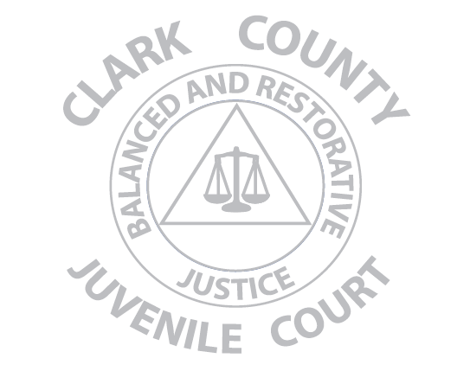
Dedicated to addressing Harm, Competency, and Community in a Restorative Way

Slide 2
RESTORATIVE JUSTICE MODEL
Community
public safety/healthy community
community Involvement
Victims
harms meaningfully addressed
a voice, meaningful input
Offenders
accountability, make amends
integration into the community

Slide 3
“Traditional” vs. “Restorative Justice”
Crime is an act against the state, a violation of a law, an abstract idea
Offender accountability defined as taking punishment
Punishment is effective: Threats of punishment deter crime Punishment changes behavior
Focus on establishing blame or guilt, on the past (did he/she do it?)
Community on sideline, represented abstractly by state
Crime is harm against another person and the community
Accountability defined as assuming responsibility and taking action to repair harm
Punishment alone is not effective in changing behavior and is disruptive to community harmony and good relationships
Focus on the problem solving, on liabilities/obligations, on the future (what should be done?)
Community as facilitator in restorative process

Slide 4
Clark County Juvenile Court
Restorative
Community
Service

Slide 5

Accountability
Making things right by taking responsibility for the harms done

Slide 6
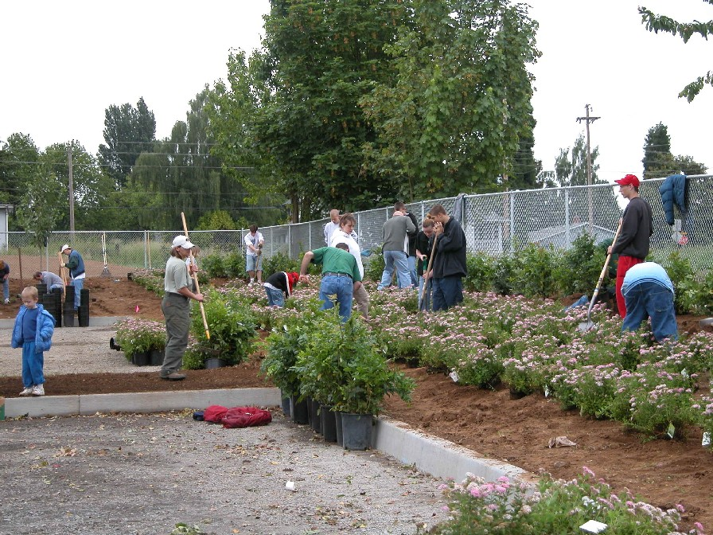
Change
Changing the way your community looks and the way your community looks at you

Slide 7
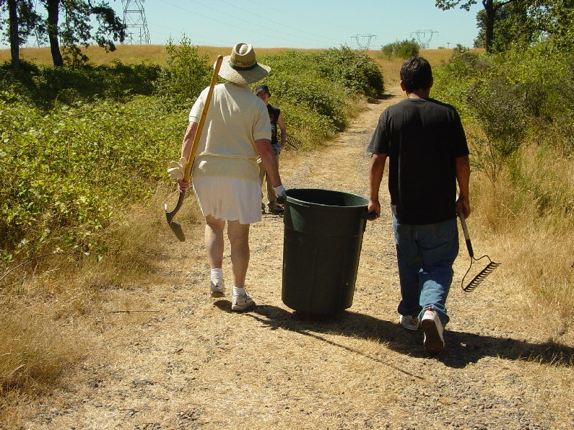
Integration

Slide 8
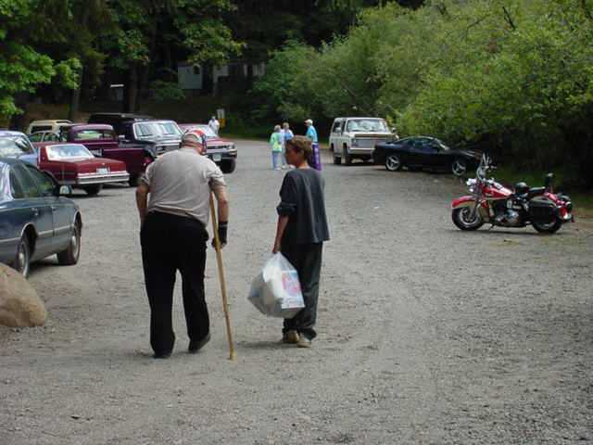
Offenders seeing THE VALUE of their service for victims and the community.

Slide 9
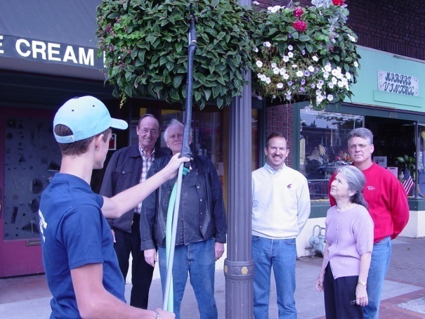

Working in partnership with responsible community members on tasks the community values.

Slide 10
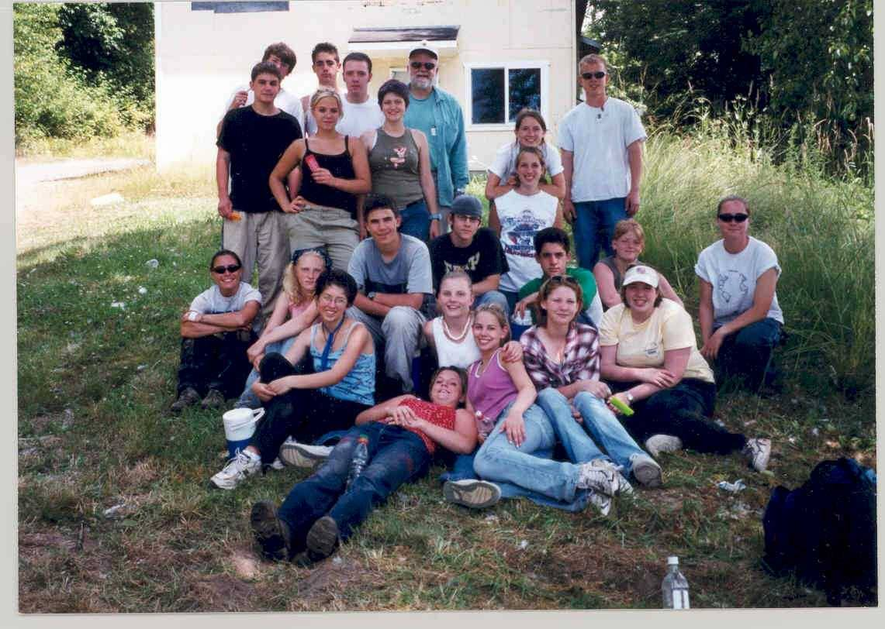
Family of Christ Lutheran Church
Which ones are the offenders?

Slide 11
Does RCS Work?
450 projects a year
80 different community partners
Over a 10 year period, 80 -85% yearly completion rate for court ordered community service hours

Slide 12
Victim Impact Program
Working in a balanced and restorative way means meeting the needs of victims:
Acknowledgement of the harm done
providing information about the justice system
A voice in the process
Participation
A Victim Impact Report is provided to the Prosecutor, Diversion and/or Probation Counselor to further integrate the victims voice into the process.

Slide 13
CLARK COUNTY JUVENILE COURT
MORE INFORMATION CAN BE FOUND ON OUR WEBSITE: http://www.clark.wa.gov/juvenile/index.html
Patrick Escamilla (360) 397-2201 ext. 4035
Christine Simonsmeier (360) 397-2201 ext. 4833

